Slide 1
Building a Universal Coordinate Method for scRNA-seq Data
Gao Haoxiang
2020/10/22

Slide 2
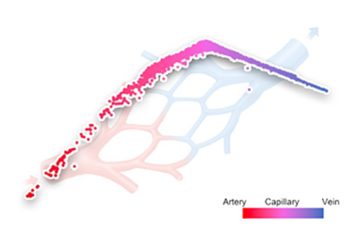
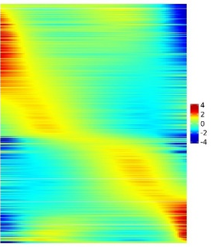
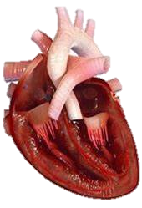
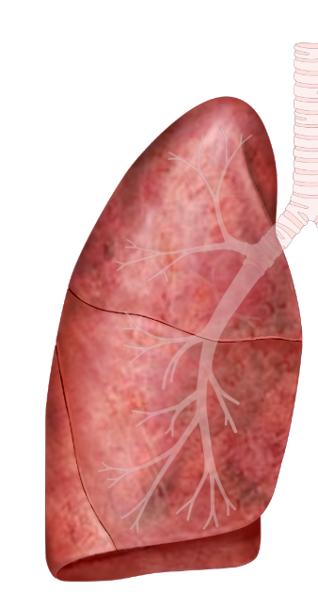
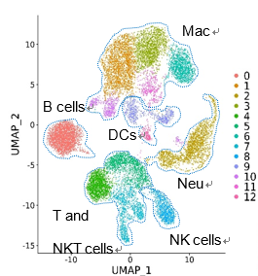
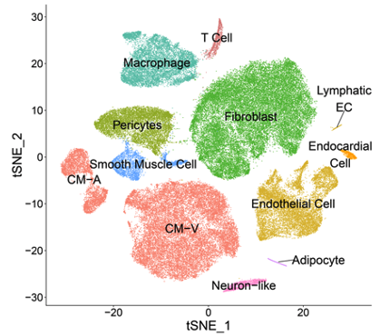
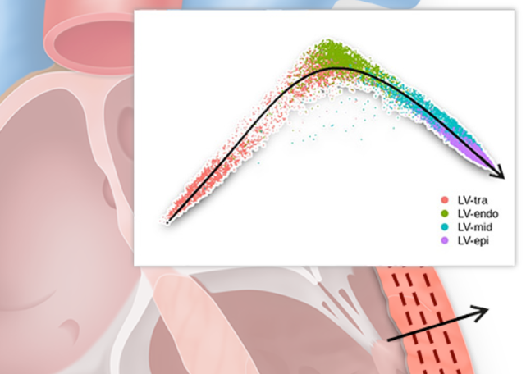
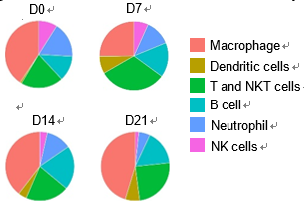
Heterogeneity in scRNA-seq Data

Slide 3
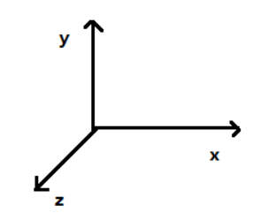

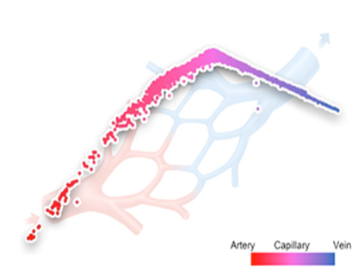
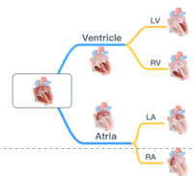
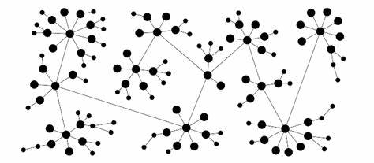
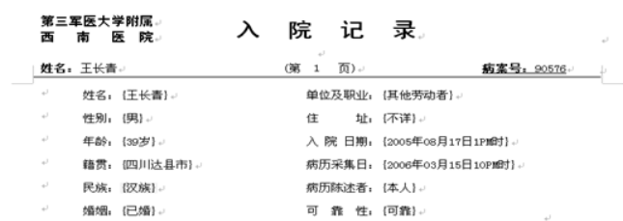
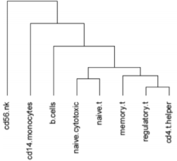
Types of Heterogeneity
3
2
1
Discrete/Continuous
with structure
Spatial/Temporal/Functional
Collected/Derived
Collected
Derived
Spatial
Discrete
Functional
Continuous

Slide 4
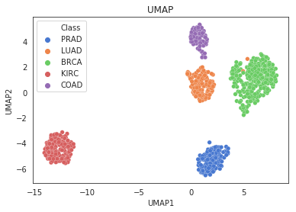
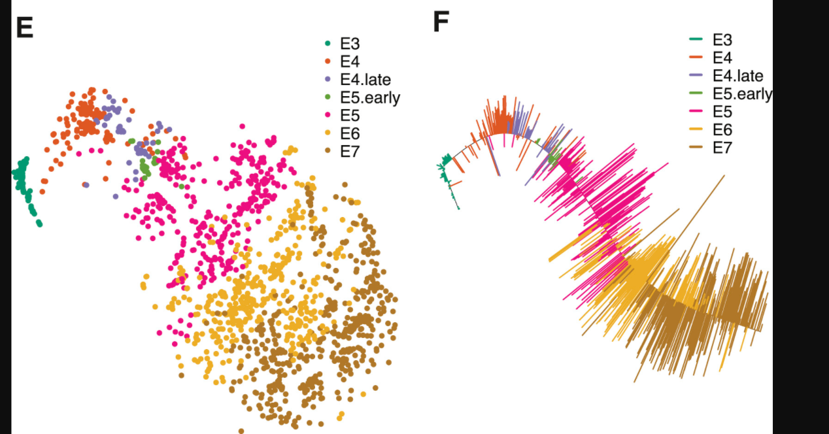
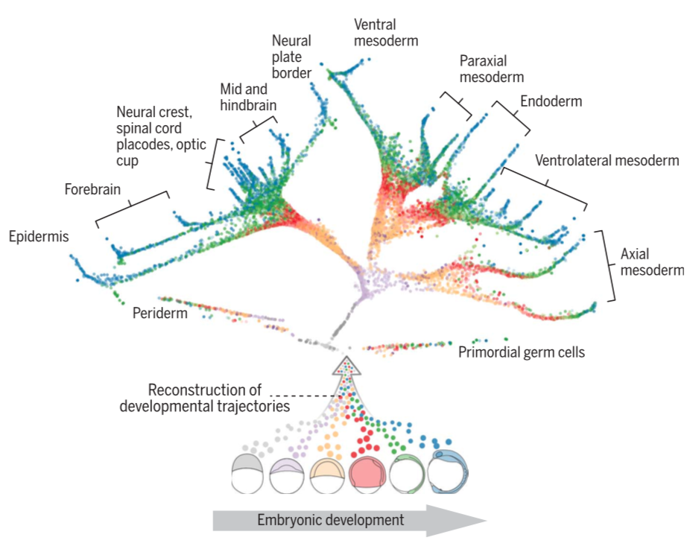
Classification of Heterogeneity
Discrete
Continuous
Structured

Slide 5
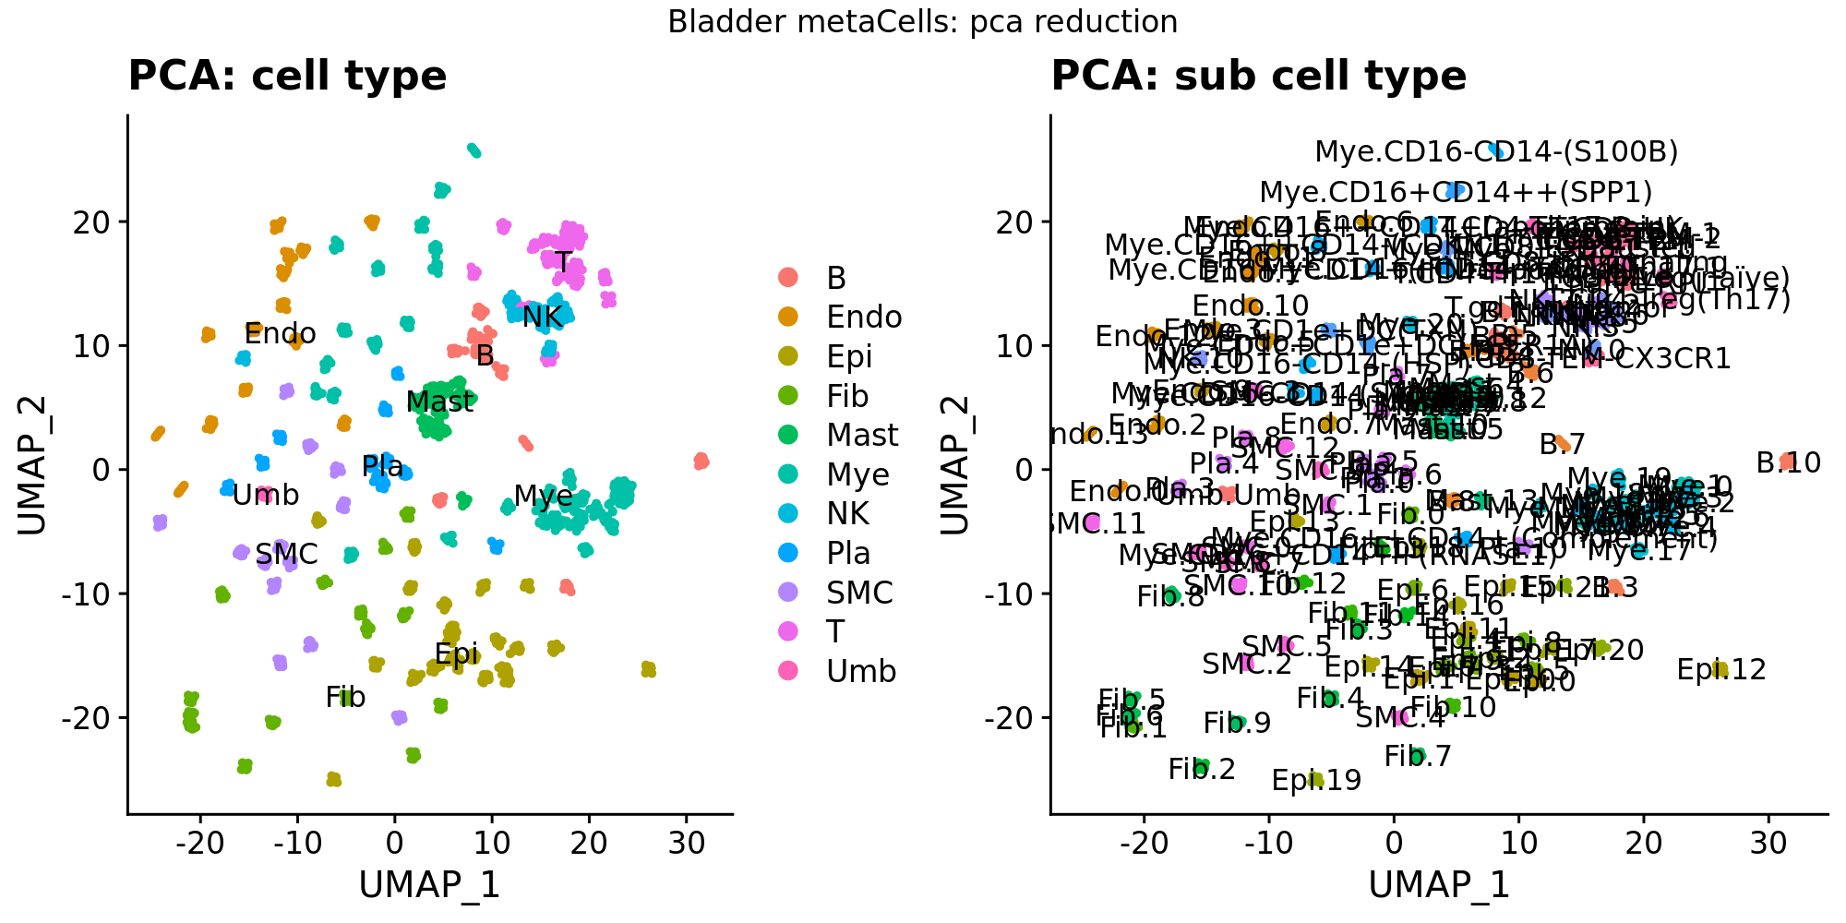
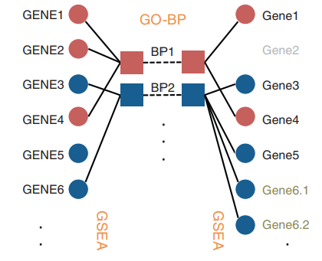
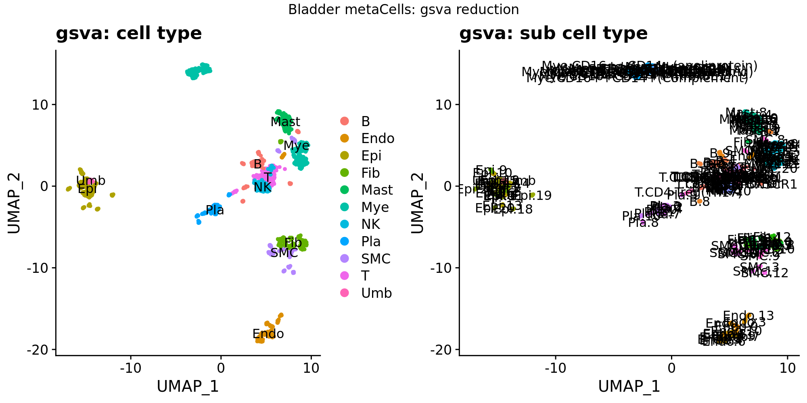
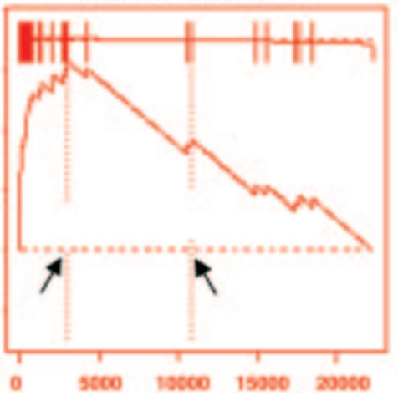
Heterogeneity as Representation of Cells
GSVA score as reduction
Supervised
Restricted to prior knowledge

Slide 6
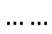
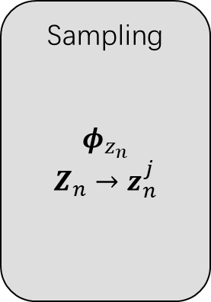
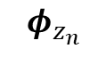
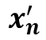

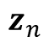
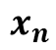
Classical VAE
Encoder
Decoder
Sampling
$$φ_{z_{n}}$$
$$Z_{n}→z_{n}^{j}$$
$$z_{n}$$
$$x_{n}$$
$$……$$
$$φ_{z_{n}}$$
$$……$$
$$x_{n}^{′}$$
Gaussian latent: only continuous
Completely unsupervised
Cannot make use of prior knowledge

Slide 7
Universal Coordinate Method
Continuous
PCA
VAE
UniCoord
Regression
MLP
Unsupervised
Supervised
Kmeans
Louvain
SVM
Random Forest
Discrete

Slide 8
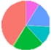

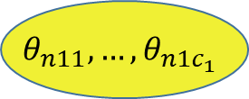
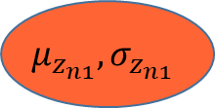
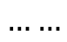
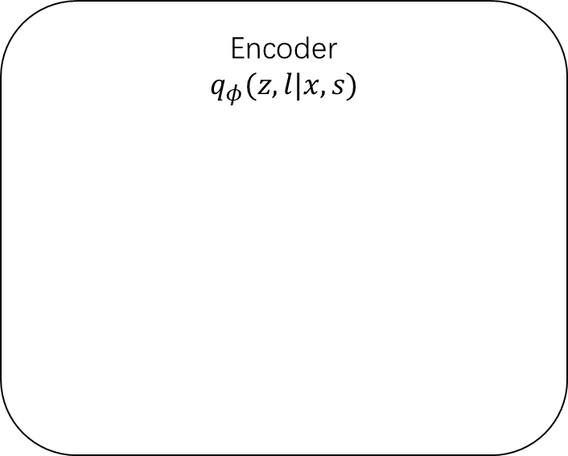
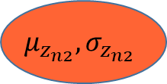
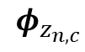
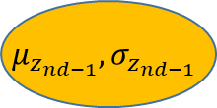
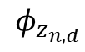
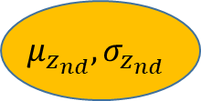
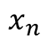
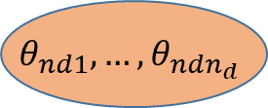
Encoder
Disc
$$θ_{n11},…,θ_{n1c_{1}}$$
Supervised
$$θ_{nd1},…,θ_{ndn_{d}}$$
Encoder
$$q_{φ}(z,l|x,s)$$
Cont
$$φ_{z_{n,d}}$$
$$μ_{z_{n1}},σ_{z_{n1}}$$
$$x_{n}$$
$$μ_{z_{n2}},σ_{z_{n2}}$$
$$……$$
$$φ_{z_{n,c}}$$
…
$${μ_{z_{nd−1}},σ}_{z_{nd−1}}$$
observed genes
unsupervised
discrete
parameters
supervised
discrete
parameters
unsupervised
continuous
parameters
supervised
continuous
parameters
$${μ_{z_{nd}},σ}_{z_{nd}}$$

Slide 9
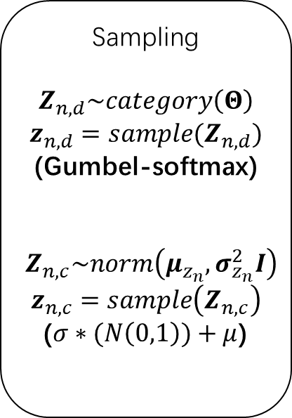
Reparameterization
Encoder
$$q_{φ}(z,l|x,s)$$
Sampling
$$Z_{n,d}\sim category\left(Θ\right)$$
$$z_{n,d}=sample(Z_{n,d})$$
(Gumbel-softmax)
$$Z_{n,c}\sim norm\left(μ_{z_{n}}, σ_{z_{n}}^{2}I\right)$$
$$z_{n,c}=sample\left(Z_{n,c}\right)$$
($σ∗(N\left(0,1\right))+μ$)
$$φ_{z_{n,d}}$$
$$x_{n}$$
$$……$$
$$φ_{z_{n,c}}$$
observed genes
unsupervised
discrete
parameters
supervised
discrete
parameters
unsupervised
continuous
parameters
supervised
continuous
parameters

Slide 10
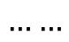
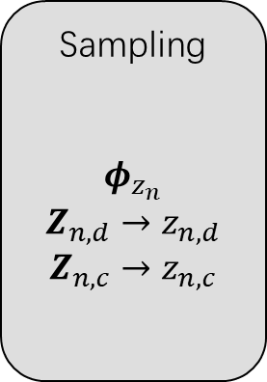
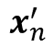
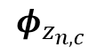
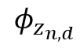
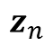
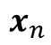
UniCoord
Labels
Batch
Pseudo-time
Cell Type
Function
score
Encoder
Decoder
$$φ_{z_{n,d}}$$
Sampling
$$φ_{z_{n}}$$
$$Z_{n,d}→z_{n,d}$$
$$Z_{n,c}→z_{n,c}$$
$$z_{n}$$
$$……$$
$$x_{n}$$
$$……$$
$$x_{n}^{′}$$
$$φ_{z_{n,c}}$$
observed genes
unsupervised
discrete
parameters
supervised
discrete
parameters
unsupervised
continuous
parameters
supervised
continuous
parameters
Supervise

Slide 11
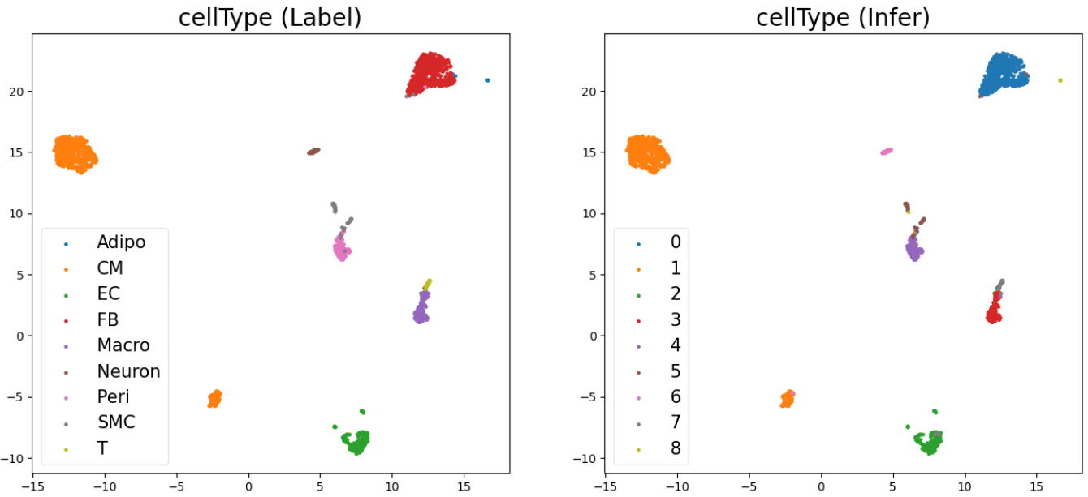
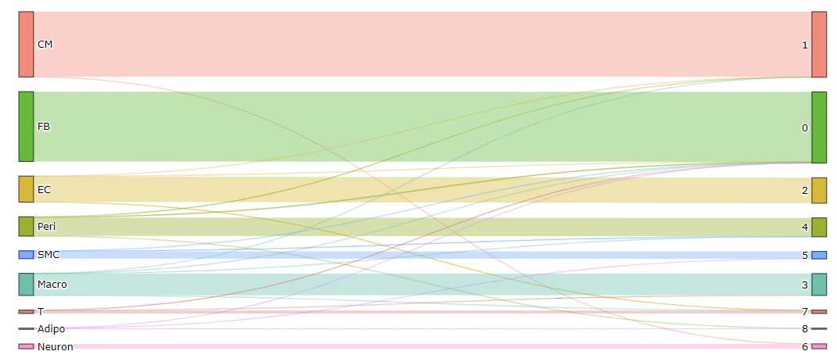
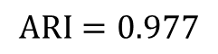
Experiment on Heart Atlas Data
$$ARI=0.977$$

Slide 12


Experiment on Heart Atlas Data
$$R^{2}=0.928$$

Slide 13


Experiment on Heart Atlas Data
$$R^{2}=0.945$$

Slide 14







Experiment on multi-organ Endothelial Cells
Organ
$$R^{2}=0.992$$

Slide 15



Experiment on LV-CM: Regression
Training Set
Test Set

Slide 16

Experiment on LV-CM : Reconstruction

Slide 17


Experiment on PBMC 3k Data
Subtypes

Slide 18





$$0.711$$
$$0.788$$
$$ARI=0.966$$
$$0.875$$

Slide 19
Future Plan
Dynamic learning rate/lambda
Encourage independence between some latent dims and others
Between supervised dims & unsupervised dims
Between dims needed to be remove & others
Structural loss in continuous case
Maximize the interpretable representation part
Bigger model, larger dataset to train the bigger model
Digital based experiments
Perturb functions in latent dims

Slide 20


Summaries
Find Inner
Structure
Diffusion
Cell heterogeneity:
Information of data
Discrete/Continuous with structure
Can be representation of cells
UniCoord:
Combine supervised and unsupervised learning
Represent all kinds of cell heterogeneity
A universal coordinate system for scRNA-seq data
Batch Resistance
Classification
Regression

Slide 21
THANKS

Slide 22









Loss Functions
$$\left.L_{recons}=MSE(x_{n}^{′},x_{n}\right)$$
$$L_{GaussianKL}=\frac{1}{n}\sum_{n,c}{\left.KL(N\left(μ_{nc},σ_{nc}^{2}\right),N(0,1)\right)}$$
$$L_{CategoryKL}=\frac{1}{n}\sum_{n,d}{KL(Cat\left(Θ_{n,d}\right),Cat\left(\frac{1}{N_{d}}\right))}$$
$$L_{Diffusion}=\frac{1}{n}\sum_{n}{MSE(x_{n_{knn}}^{′},x_{n})}$$
$$L_{Clustering}=\frac{1}{n}\sum_{n}{S_{within}^{2}−S_{between}^{2}}$$
$$L_{Regression}=\frac{1}{n}∑MSE(μ_{Z_{n,c}},label)$$
$$L_{Classification}=\frac{1}{n}∑ARI(Θ_{n,d},label_{d})$$
$$L_{Tree}=\sum_{l}{Tree_{l−1,l}∗Cooccur(Θ_{l−1},Θ_{l})}$$

Slide 23

Gumbel-Softmax

Slide 24

Experiment on multi-organ Endothelial Cells

Slide 25

Experiment on PBMC 3k Data

